Slide 1
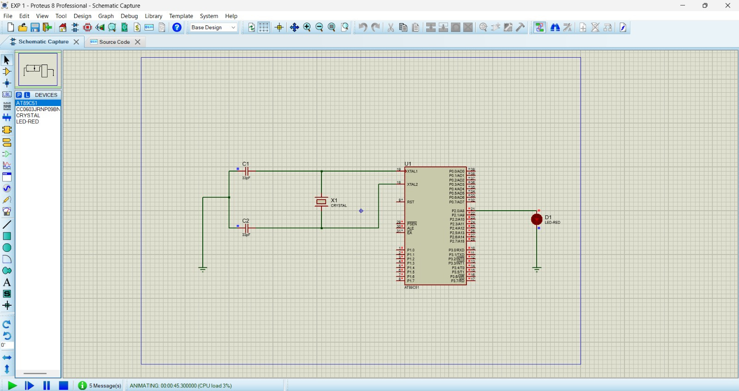
EXPERIMENT 1
Objectives:
To study the basic operaton of AT89051 Microcontroller.
To interface an LED with Microcontroller.
To generate lED blinking using a Software delay row.
PROGRAM :
ORG 0000H
UP: SETB P2.0
ACALL DELAY
CLR P2.0
ACALL DELAY
SJMP UP
DELAY: MOV R4,#35
H1:MOV R3,#255
H2:DJNZ R3,H2
DJNZ R4,H1
RET
END
Output:

Slide 2
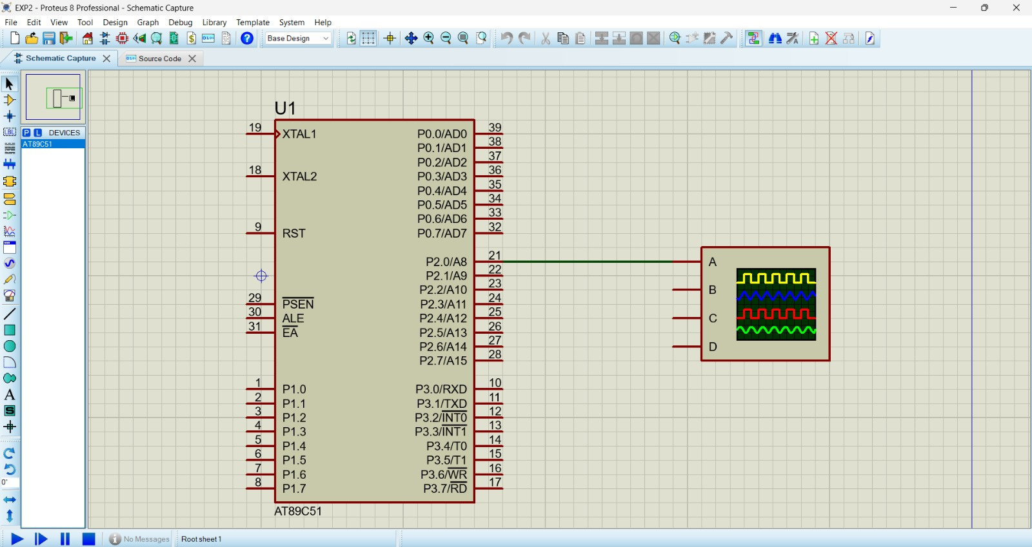
EXPERIMENT 2
Objectives:
To generate a Square wave using A789051.
To study port taggling operation.
To observe wave form Using an an osclloscope in proteus.
PROGRAM :
ORG 0000H
UP: SETB P2.0
ACALL DELAY
CLR P2.0
ACALL DELAY
SJMP UP
DELAY: MOV R4,#35
H1:MOV R3,#255
H2:DJNZ R3,H2
DJNZ R4,H1
RET
END
Output:

Slide 3
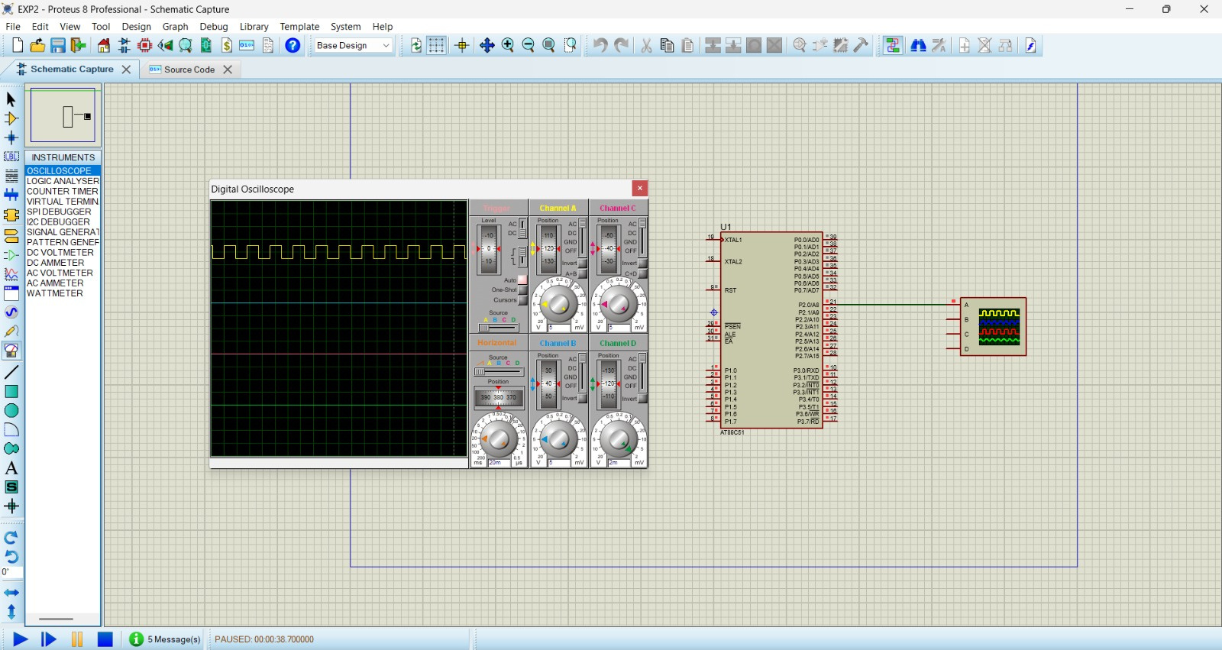
EXPERIMENT 3
Objectives:
To generate a square wave using A18905
To study Stepping sequene of a Stepper Motor
To control rotational movement using assembly languags.
PROGRAM:
ORG 0000H
UP: MOV P2,#09H
ACALL DELAY
MOV P2,#0CH
ACALL DELAY
MOV P2,#06H
ACALL DELAY
MOV P2,#03H
ACALL DELAY
SJMP UP
DELAY:MOV R4,#18
H1:MOV R3,#255
H2:DJNZ R3,H2
DJNZ R4,H1
RET
END

Slide 4
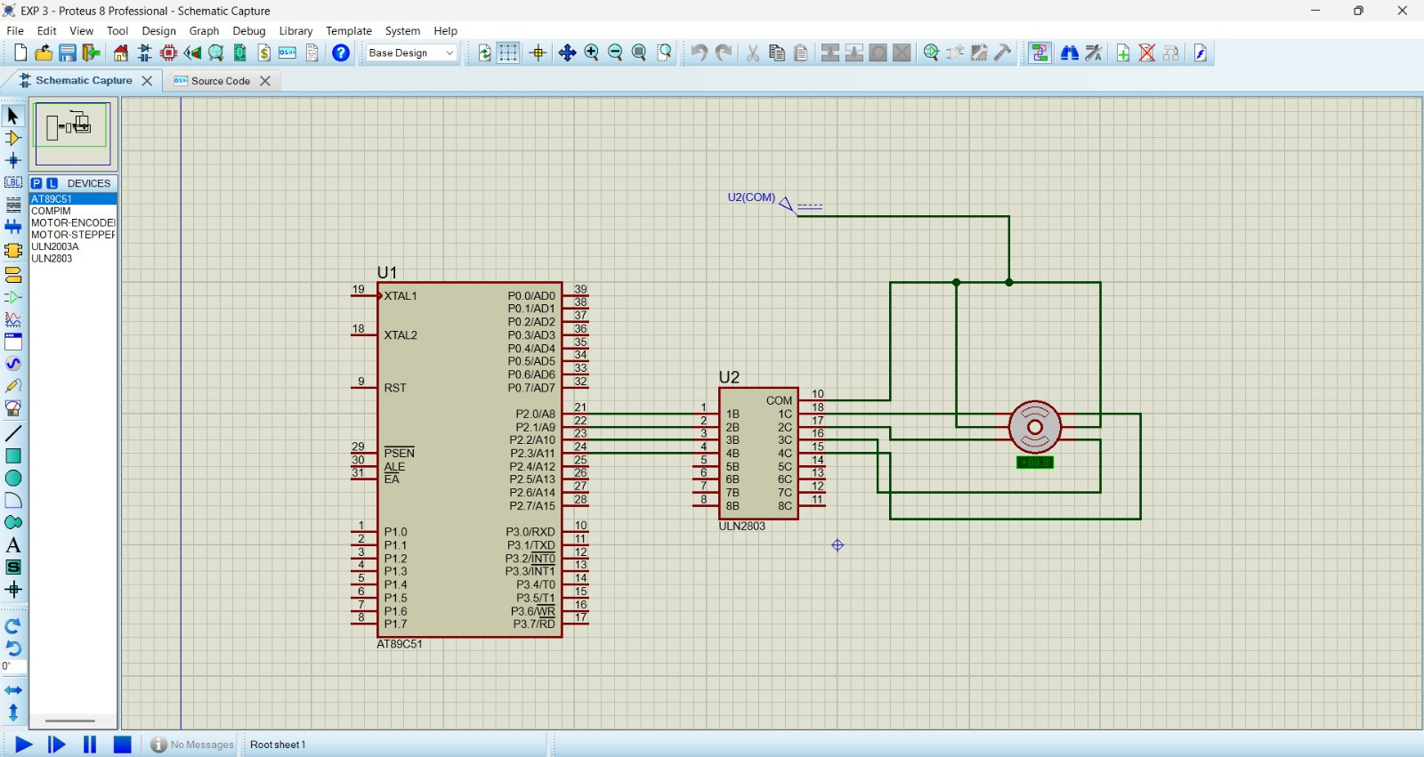
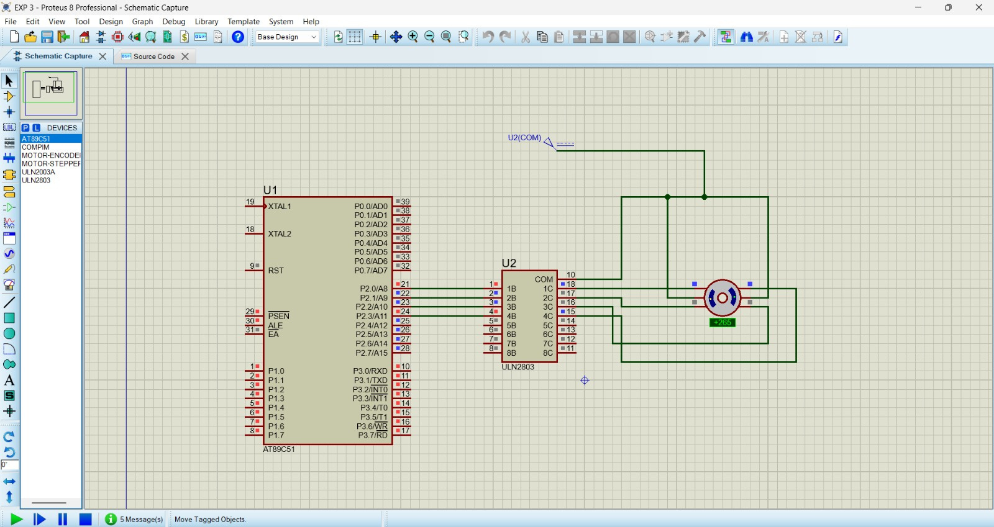
Output:

Slide 5
EXPERIMENT 4
Objectives:
To Interface a 7 segment display with 1789051.
To display decimal digits using Segment data.
To understand output display interfacing.
PROGRAM:
ORG 000H
UP:MOV P2,#0C0H
ACALL DELAY
MOV P2,#0F9H
ACALL DELAY
MOV P2,#0A4H
ACALL DELAY
MOV P2,#0B0H
ACALL DELAY
MOV P2,#99H
ACALL DELAY
MOV P2,#92H
ACALL DELAY
MOV P2,#82H
ACALL DELAY
MOV P2,#0F8H
ACALL DELAY
MOV P2, #80H
ACALL DELAY
MOV P2,#90H
ACALL DELAY
DELAY: MOV R5,#10
H1:MOV R4,#180
H2:MOV R3,#255
H3:DJNZ R3,H3
DJNZ R4,H2
DJNZ R5,H1
RET
END

Slide 6
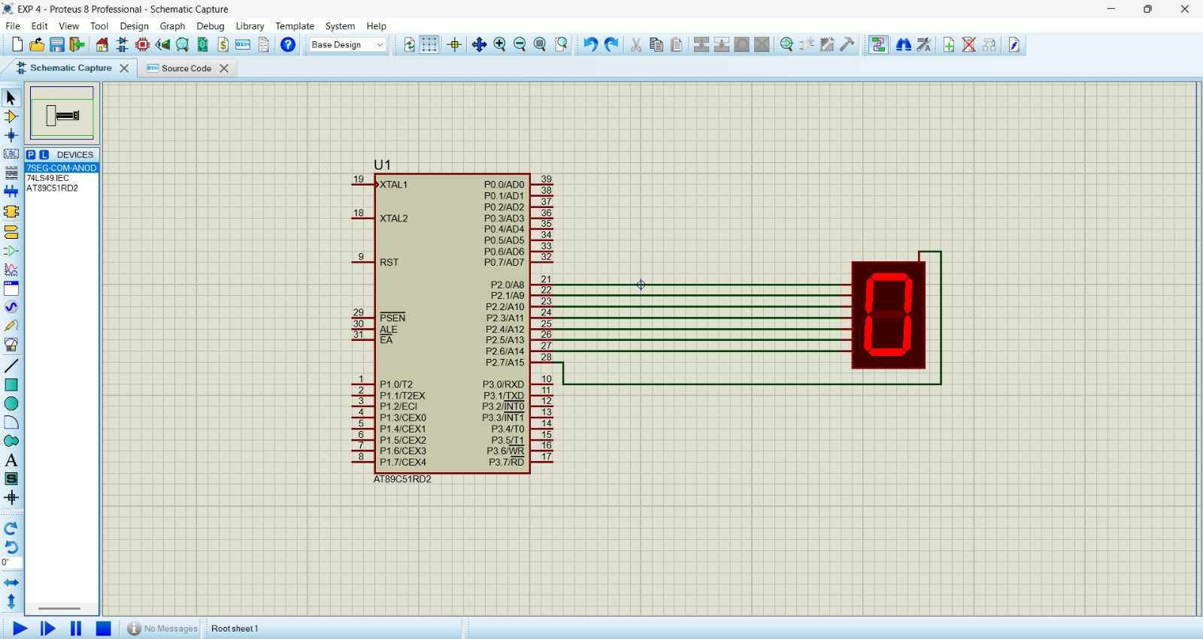
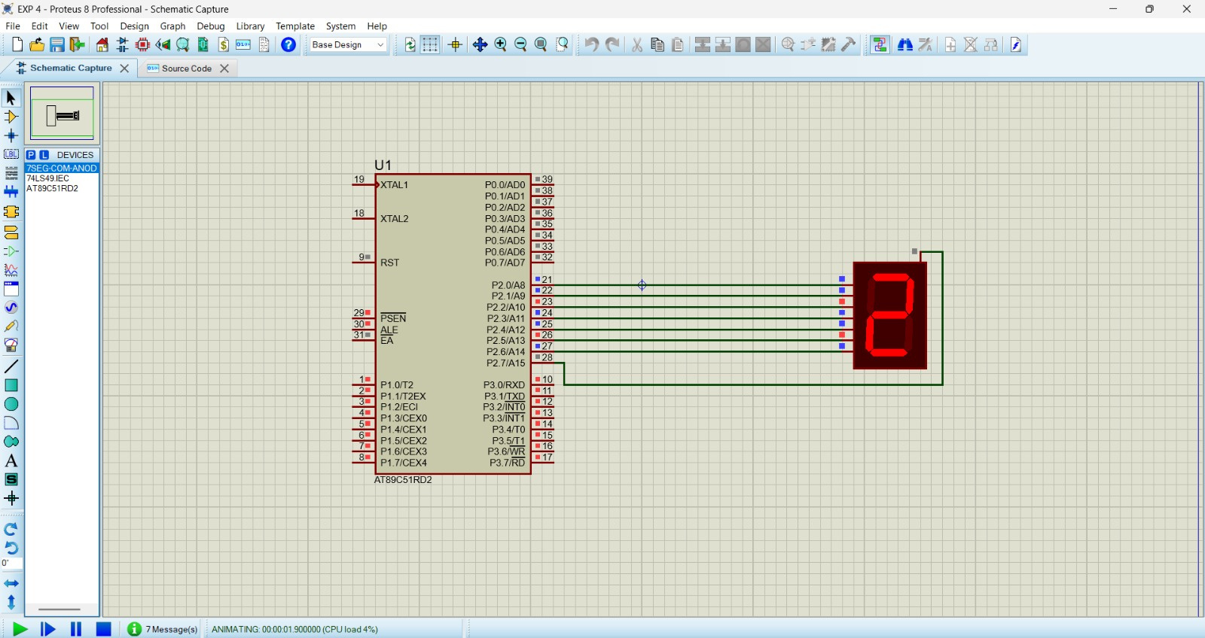
Output:

